Slide 1
Pricing Strategy Big Mountain Resort
Springboard Guided Capstone
Harikrishnan V
August 2020

Slide 2
PROBLEM SUMMARY
Ticket pricing strategy at Big Mountain Resort has been just to price at a certain premium over the average market prices.
This is very vague and arbitrary.
We need to develop a better data driven pricing strategy.
With the nationwide resort data :
We can find out the actual value of the features in the resort.
We can also find the features that most contribute to ticket price and take action.

Slide 3
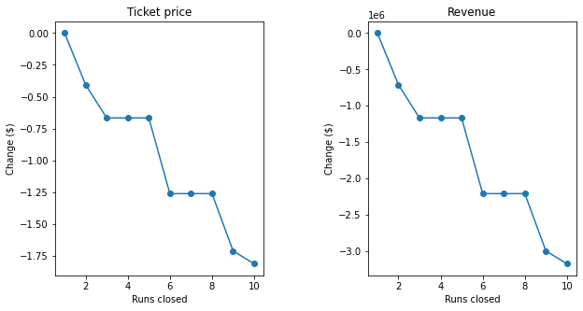
Recommendation and key findings
About ticket price
Big Mountain Resort supports a ticket price of $95.87 with a mean error of $10.39, against the current $81.00.
(Considering 350,000 seasonal visitors, each spending 5 days)
About permanently closing down up to 10 of the least used runs

Slide 4
Recommendation and key findings
About increasing the vertical drop by adding a run to a point 150 feet lower down + installation of an additional chair
Increases support for ticket price by $1.99
$3474638 increase in ticket income over the season
About additional 2 acres of snow making coverage to above scenario
Same as above!
Such a small increase in the snow making area makes no difference!
About increasing longest run by 0.2 miles + add snow making coverage of 4 acres
No difference whatsoever.
Longest run is not a very important feature influencing pricing.

Slide 5
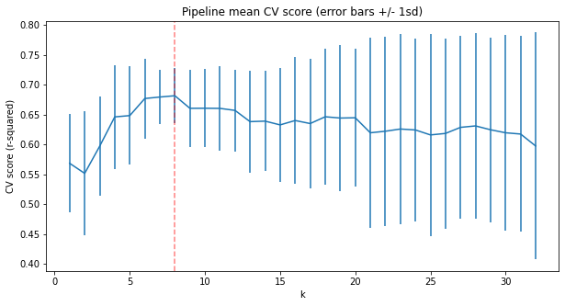
Modeling results and analysis
1. MEAN OF PRICES MODEL
Mean Error of: $17.92 on train data, $19.13 on test data
2. LINEAR REGRESSION MODEL

Slide 6
Modeling results and analysis
2. LINEAR REGRESSION MODEL
Feature importance coefficients
vertical_drop 10.767857
Snow Making_ac 6.290074
total_chairs 5.794156
fastQuads 5.745626
Runs 5.370555
LongestRun_mi 0.181814
trams -4.142024
SkiableTerrain_ac -5.249780
Mean Error of :
$10.50 on train data $11.79 on test data

Slide 7
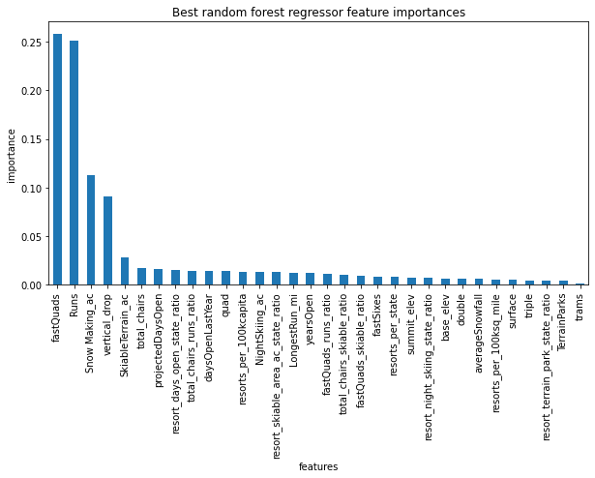
Modeling results and analysis
3. RANDOM FOREST MODEL
Best model was with 69 trees
Feature importance
Mean Error of :
$9.64 on train data $9.54 on test data

Slide 8
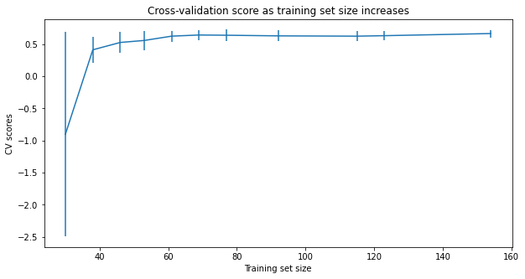
Modeling results and analysis
DATA QUANTITY ASSESSMENT
More than adequate data quantity

Slide 9
Summary
MODEL RESULTS
RANDOM FOREST MODEL
A ticket price of $95.87 is supported with a mean error of $10.39, against the current $81.00
Mean of prices:
Linear Regression:
Random Forest:
Error (train) | Error (test)
17.92 | 19.13
10.50 | 11.79
9.64 | 9.54

Slide 10
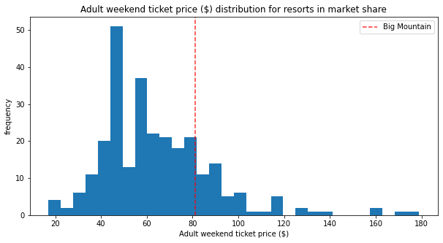
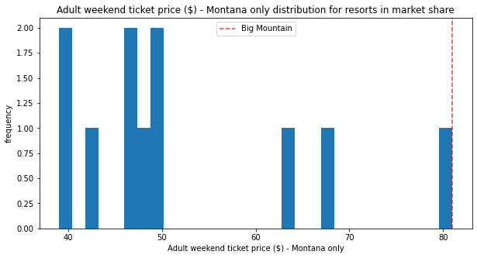
Conclusion
BIG MOUNTAIN PRICES COMPARED TO MARKET:

Slide 11
Conclusion
FEATURES THAT ARE IMPORTANT:
vertical_drop
Snow Making_ac
total_chairs
fastQuads
Runs
LongestRun_mi
trams
SkiableTerrain_ac

Slide 12
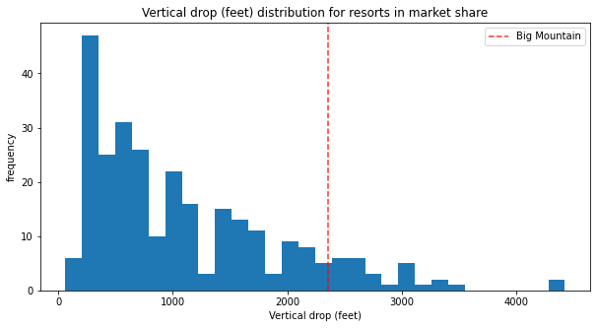
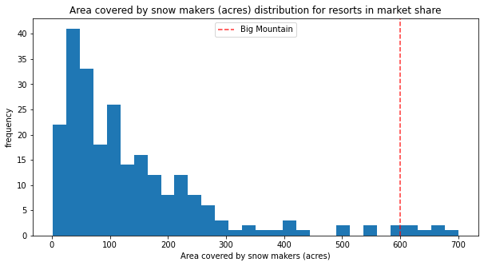
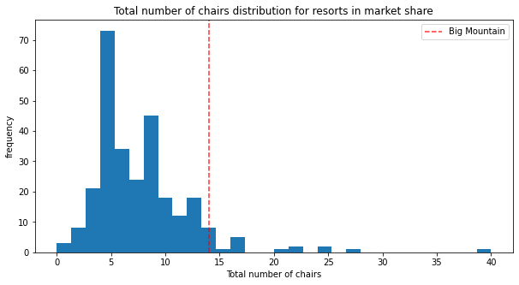
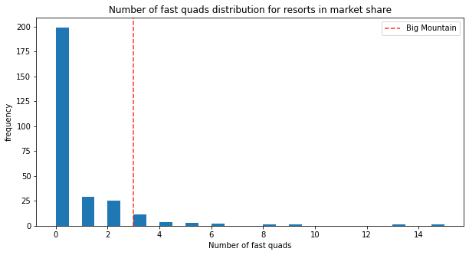
Conclusion
HOW BIG MOUNTAIN FAIRS ON IMPORTANT FEATURES:

Slide 13
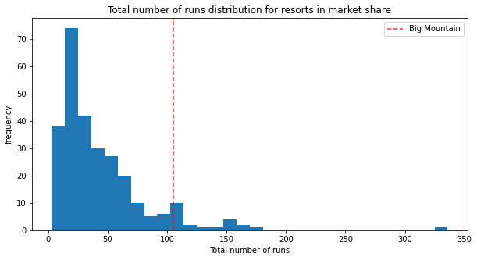
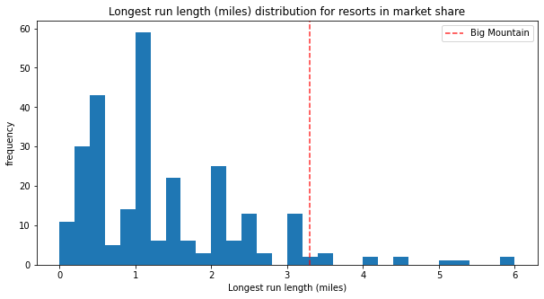
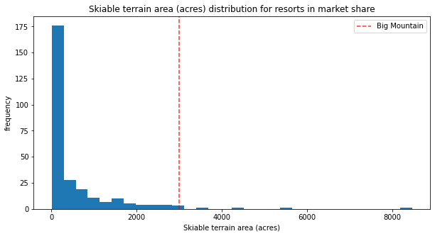
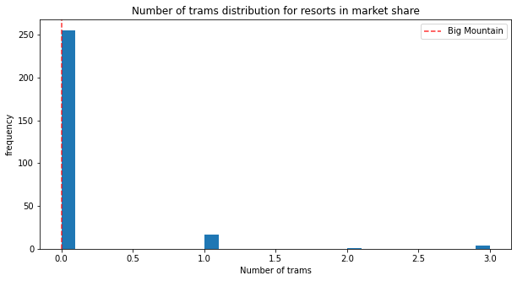
Conclusion
HOW BIG MOUNTAIN FAIRS ON IMPORTANT FEATURES:

Slide 14

THANK YOU
Data Science Career Track
Springboard India
August 2020

